Slide 1


Deep Learning Theory and Applications Machine Learning Overviewearning Basics
CPSC/AMTH/CBB 663
CPSC 452

Slide 2

What is machine learning?
xkcd.com/1838

Slide 3
Announcements
Tomorrow at 3pm: Kincaid tutorial on Getting Set Up
Sunday 9-11am: Creating a neural network in pytorch
See blog: https://towardsdatascience.com/tabnet-deep-neural-network-for-structured-tabular-data-39eb4b27a9e4
Office hours begin next week!
Homework 1 will be assigned TONIGHT, due Feb 15
If you have questions to ask me, please ask via discord
➔ JOIN DISCORD!!
Class has a partition on the HPC Server Farnam (see canvas announcement)

Slide 4
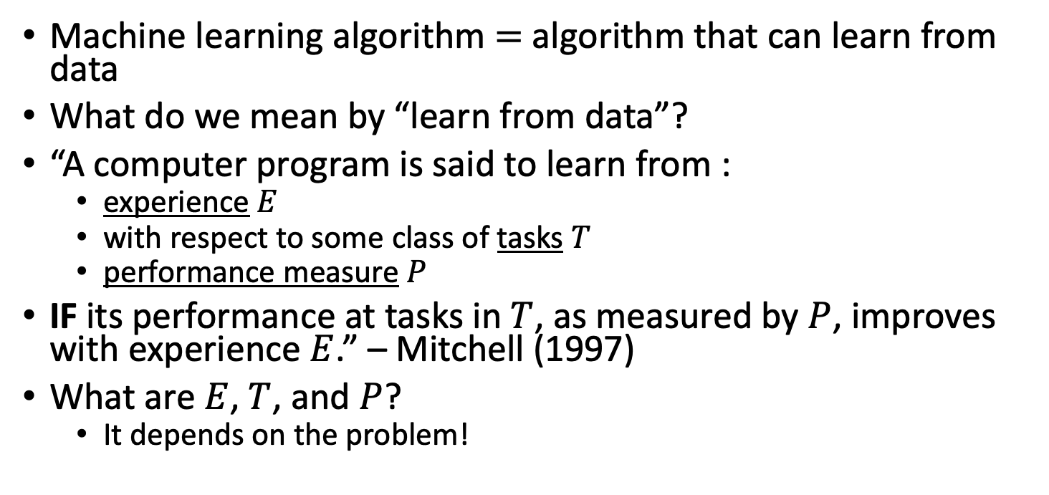
What is machine learning?
Machine learning algorithm $=$ algorithm that can learn from data
What do we mean by “learn from data”?
“A computer program is said to learn from :
experience $E$
with respect to some class of tasks $T$
performance measure $P$
IF its performance at tasks in $T$, as measured by $P$, improves with experience $E$.” – Mitchell (1997)
What are $E$, $T$, and $P$?
It depends on the problem!
Notes:
I’m not going to formally define these three things in a general setting. Rather, I’ll present them in specific contexts.

Slide 5
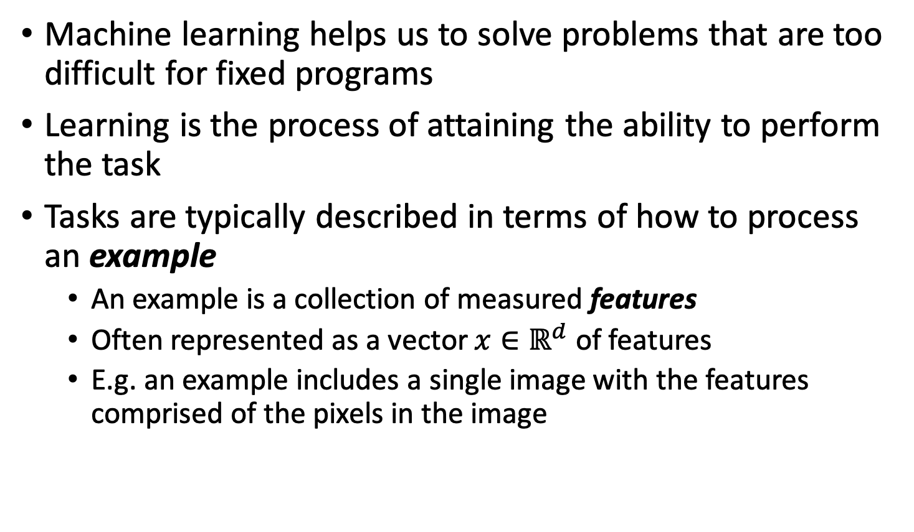
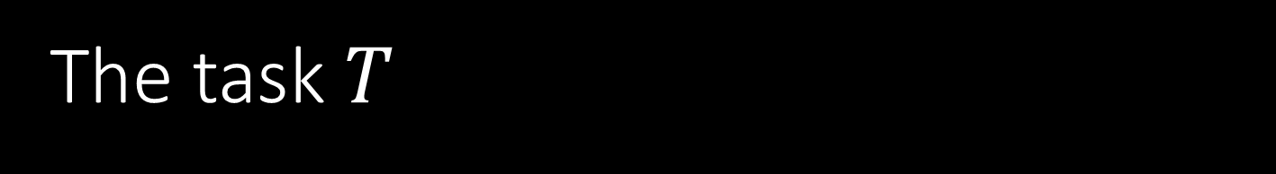
The task $T$
Machine learning helps us to solve problems that are too difficult for fixed programs
Learning is the process of attaining the ability to perform the task
Tasks are typically described in terms of how to process an example
An example is a collection of measured features
Often represented as a vector $x∈ℝ^{d}$ of features
E.g. an example includes a single image with the features comprised of the pixels in the image

Slide 6

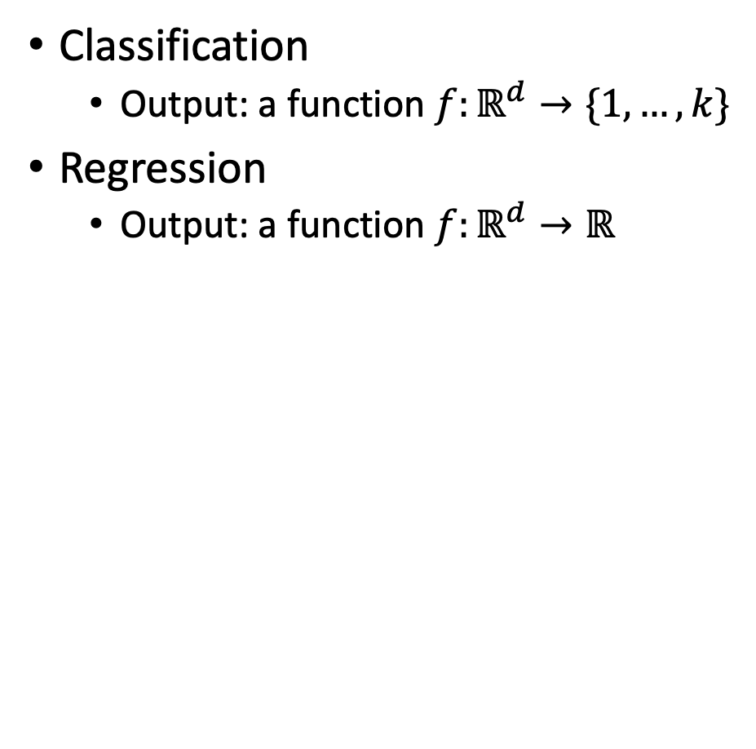
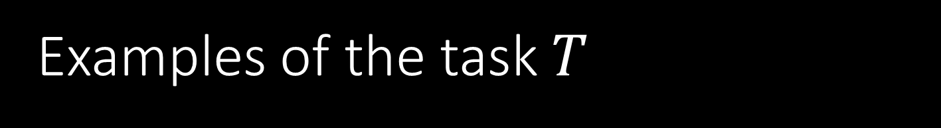
Examples of the task $T$
Classification
Output: a function $f:ℝ^{d}→\{1,…,k\}$
Regression
Output: a function $f:ℝ^{d}→ℝ$
Notes:
Predict a class. Predict a numerical value. For transcription, this includes recognizing words in images or speech processing. Machine translation includes translating from one language to another. Anomaly detection detects unusual events (e.g. credit card fraud). Synthesis and sampling includes generating new examples that are similar to training data (e.g. texture generation in video games). Imputation – mention Netflix problem and scRNA-seq. Density estimation is for learning the structure of the data which can be useful in a lot of problems

Slide 7
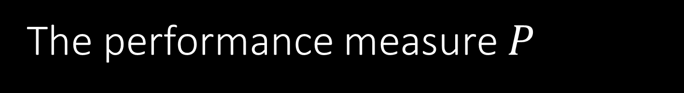
The performance measure $P$
Need a quantitative measure to evaluate a machine learning algorithm
Provides a measure to guide the selection of an algorithm
Examples:
Accuracy (or equivalently, the error rate) in a classification problem
Prediction error
Performance is typically estimated/evaluated based on a test set of data (different from training data)
Choosing a performance measure isn’t always straightforward
Notes:
In transcription, do we measure accuracy of entire sequences? Or should we use a more fine-grained measure that give partial credit.
In regression, do we penalize frequent medium-sized mistakes more? Or rare, very large mistakes? It largely depends on the application.

Slide 8
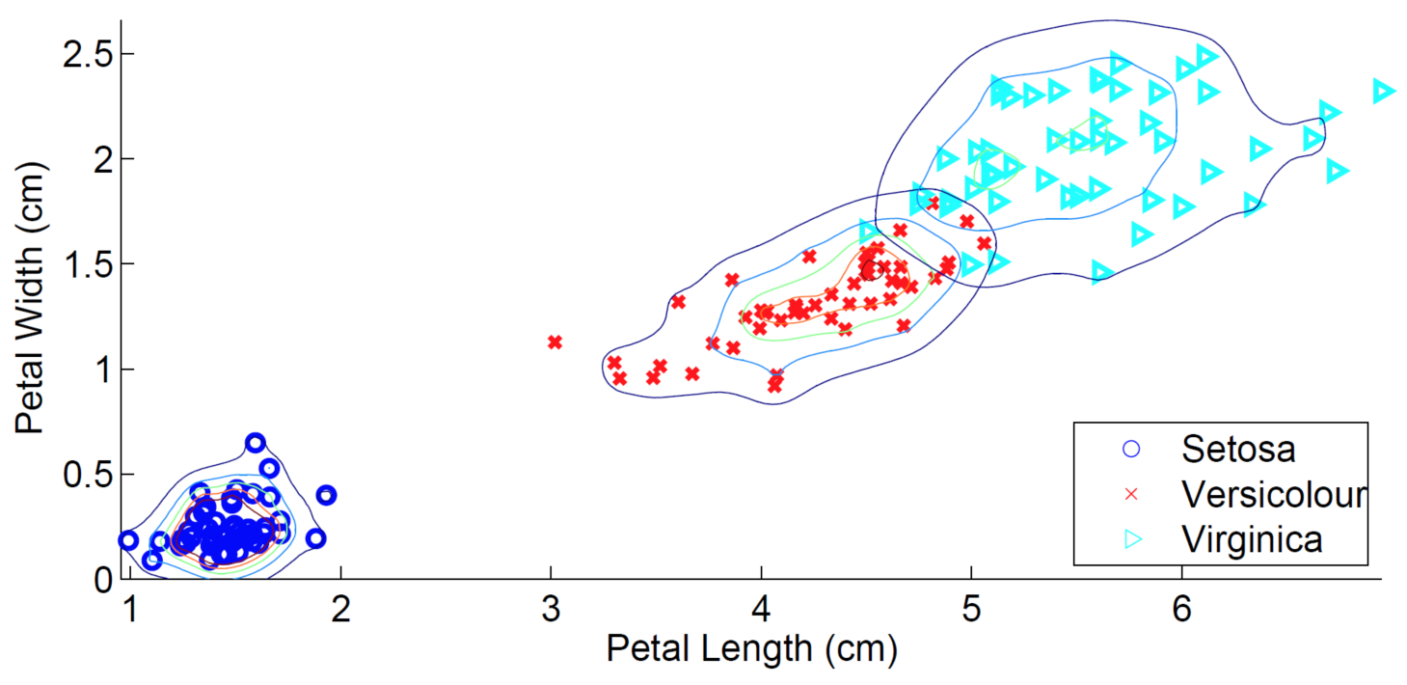
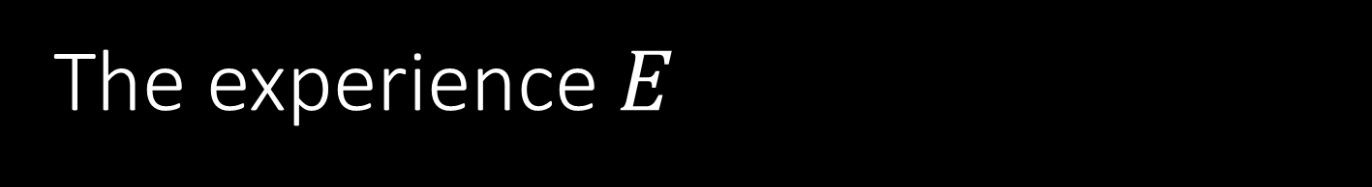
The experience $E$
Most algorithms experience an entire dataset consisting of many examples or data points
Example: Iris data set (Fisher, 1936)
Four features: sepal length, sepal width, petal length, petal width
3 species/classes, 50 data points per class

Slide 9
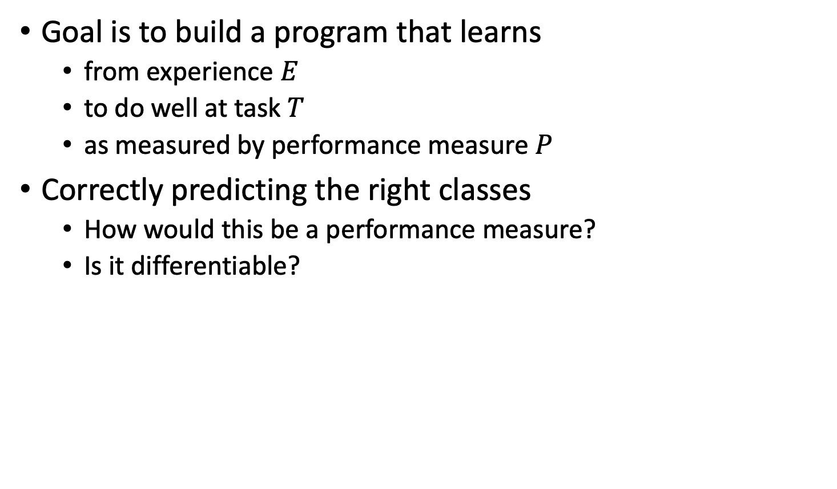
Machine learning recap
Goal is to build a program that learns
from experience $E$
to do well at task $T$
as measured by performance measure $P$
Correctly predicting the right classes
How would this be a performance measure?
Is it differentiable?

Slide 10
Supervised Learning Learning

Slide 11








Supervised learning
Have a bunch of labelled data, want to label new data
Supervised Learning Model
Noun project

Slide 12
Supervised learning
Have a bunch of labelled data, want to label new data
Supervised Learning Model
Strawberry!
Noun project

Slide 13
Supervised learning
Have a bunch of labelled data, want to label new data
Supervised Learning Model
Noun project

Slide 14
Supervised learning
Have a bunch of labelled data, want to label new data
Supervised Learning Model
Banana
Noun project

Slide 15

Supervised learning
Have a bunch of labelled data, want to label new data
Supervised Learning Model
Noun project

Slide 16
Supervised learning
Have a bunch of labelled data, want to label new data
Supervised Learning Model
Strawberry!
Noun project

Slide 17


Supervised learning
Have a bunch of labelled data, want to label new data
Supervised Learning Model
Noun project

Slide 18

Supervised learning
Have a bunch of labelled data, want to label new data
Supervised Learning Model
?
Noun project

Slide 19
Supervised learning
Have a bunch of labelled data, want to label new data
Supervised Learning Model
Strawberry!
Noun project

Slide 20
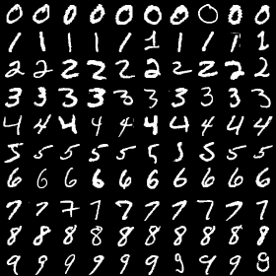
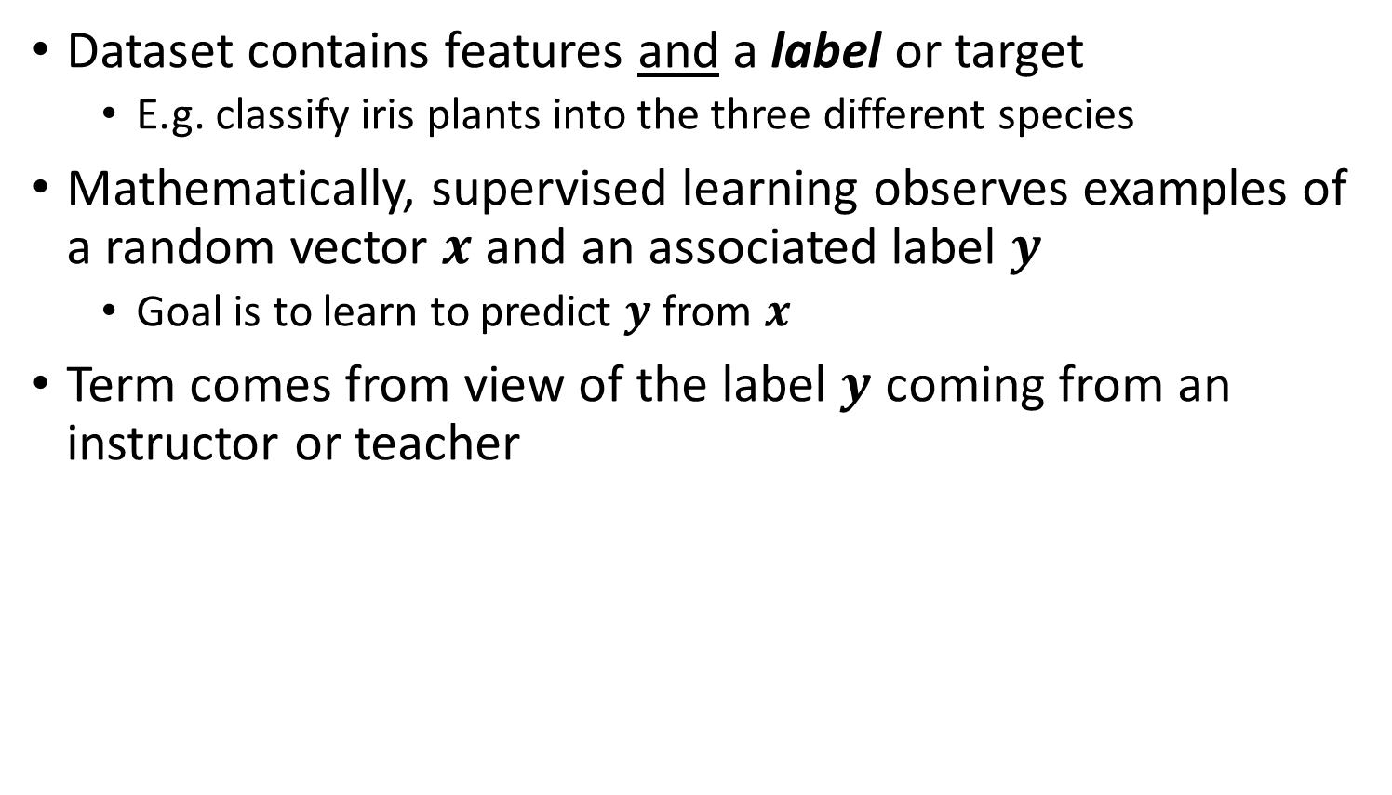
Supervised learning
Dataset contains features and a label or target
E.g. classify iris plants into the three different species
Mathematically, supervised learning observes examples of a random vector $x$ and an associated label $y$
Goal is to learn to predict $y$ from $x$
Term comes from view of the label $y$ coming from an instructor or teacher

Slide 21
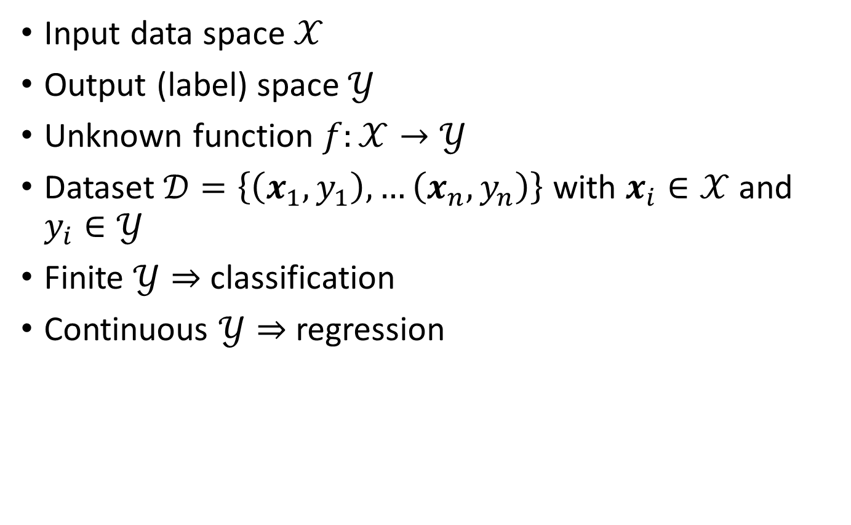
Supervised learning
Input data space $𝒳$
Output (label) space $𝒴$
Unknown function $f:𝒳→𝒴$
Dataset $𝒟=\left\{\left(x_{1},y_{1}\right),…\left(x_{n},y_{n}\right)\right\}$ with $x_{i}∈𝒳$ and $y_{i}∈𝒴$
Finite $𝒴⇒$ classification
Continuous $𝒴⇒$ regression
Notes:
We can describe the problem a bit more formally

Slide 22
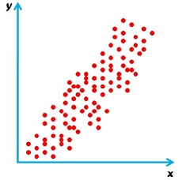
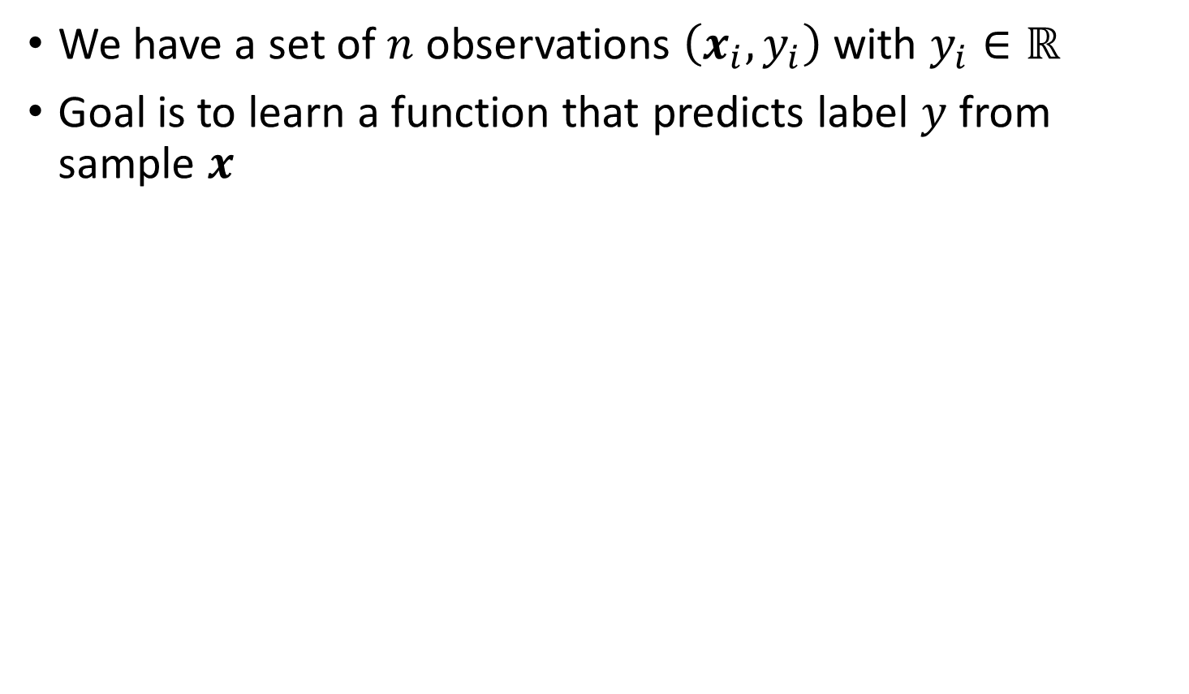
Regression
We have a set of $n$ observations $\left(x_{i},y_{i}\right)$ with $y_{i}∈ℝ$
Goal is to learn a function that predicts label $y$ from sample $x$
Surbhi S, 2016

Slide 23
Regression
Choose a model class of functions
Choose a performance measure to guide the selection of a function from the model class
We’ll begin with a simple model class: linear functions
Surbhi S, 2016

Slide 24
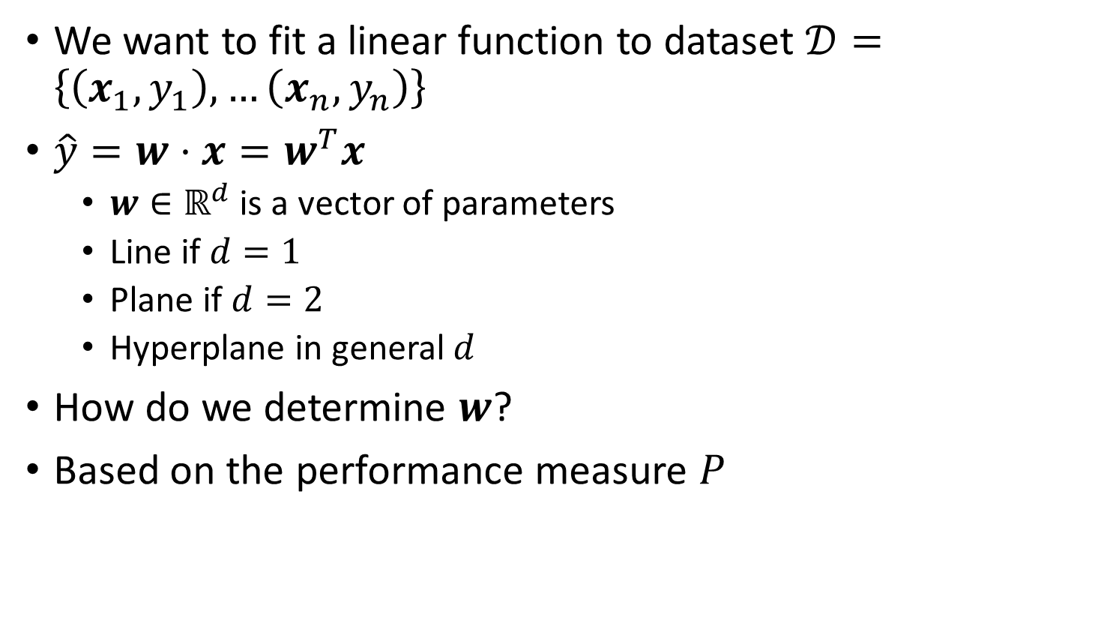
Linear Regression
We want to fit a linear function to dataset $𝒟=\left\{\left(x_{1},y_{1}\right),…\left(x_{n},y_{n}\right)\right\}$
$\hat{y}=w⋅x=w^{T}x$
$w∈ℝ^{d}$ is a vector of parameters
Line if $d=1$
Plane if $d=2$
Hyperplane in general $d$
How do we determine $w$?
Based on the performance measure $P$

Slide 25
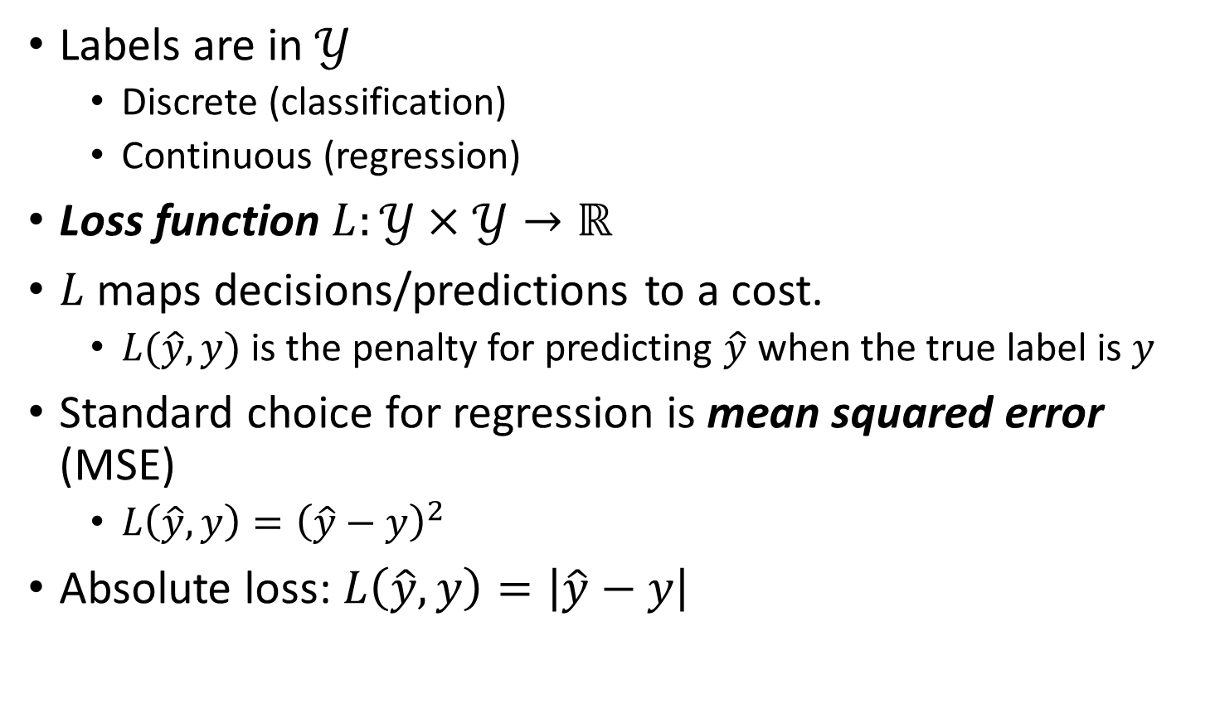
Loss functions
Labels are in $𝒴$
Discrete (classification)
Continuous (regression)
Loss function $L:𝒴×𝒴→ℝ$
$L$ maps decisions/predictions to a cost.
$L(\hat{y},y)$ is the penalty for predicting $\hat{y}$ when the true label is $y$
Standard choice for regression is mean squared error (MSE)
$L\left(\hat{y},y\right)={\left(\hat{y}−y\right)}^{2}$
Absolute loss: $L\left(\hat{y},y\right)=\left|\hat{y}−y\right|$

Slide 26
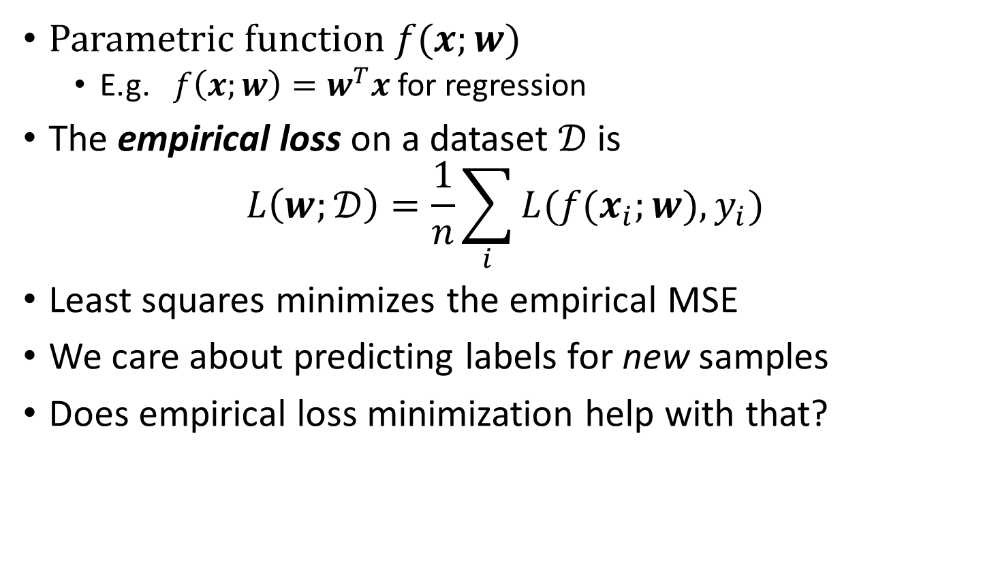
Empirical loss
Parametric function $f(x;w)$
E.g.$f\left(x;w\right)=w^{T}x$ for regression
The empirical loss on a dataset $𝒟$ is
$$L\left(w;𝒟\right)=\frac{1}{n}\sum_{i}{L(f(x_{i};w),y_{i})}$$
Least squares minimizes the empirical MSE
We care about predicting labels for new samples
Does empirical loss minimization help with that?

Slide 27
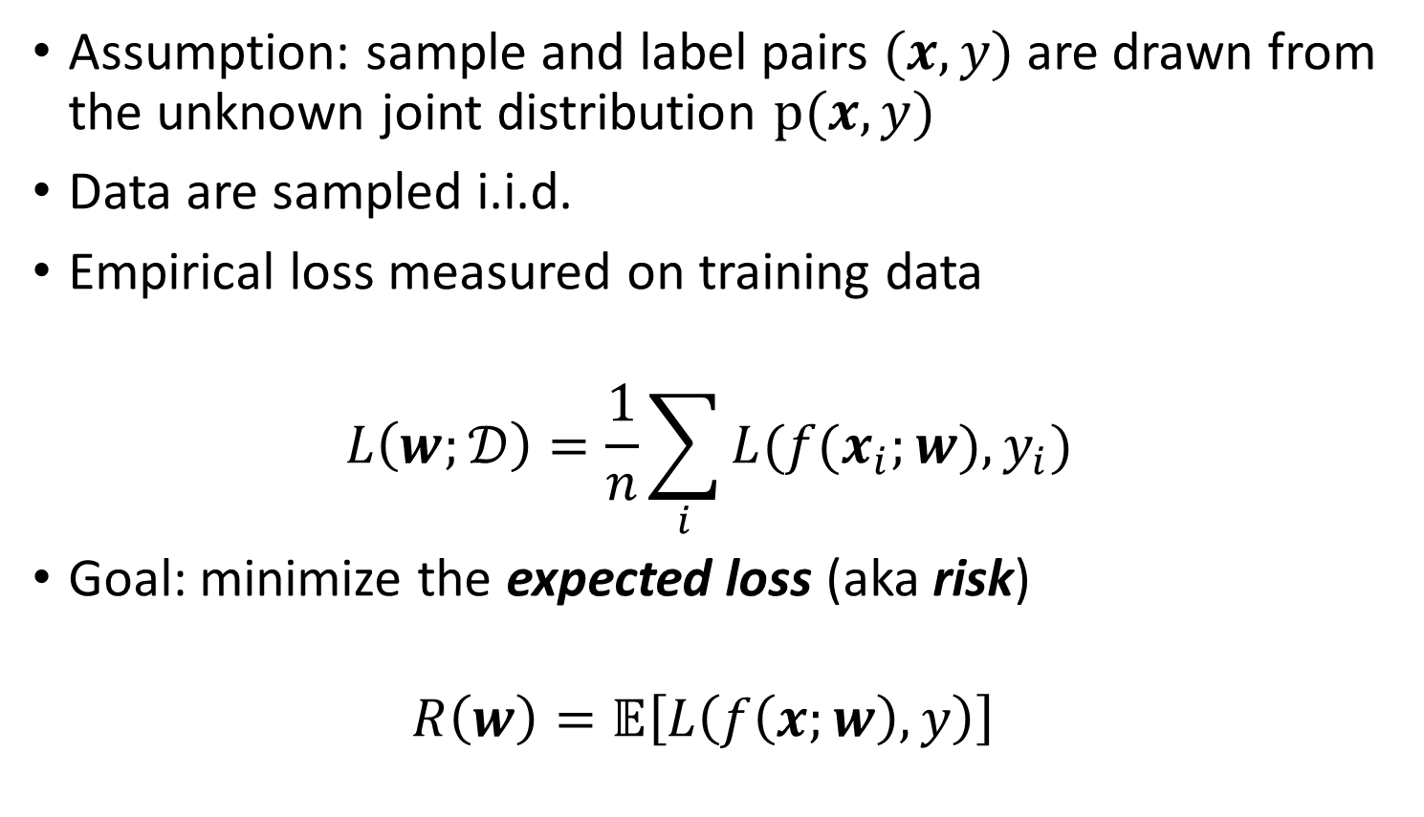
Empirical vs. Expected loss
Assumption: sample and label pairs $(x,y)$ are drawn from the unknown joint distribution $p(x,y)$
Data are sampled i.i.d.
Empirical loss measured on training data
$$L\left(w;𝒟\right)=\frac{1}{n}\sum_{i}{L(f(x_{i};w),y_{i})}$$
Goal: minimize the expected loss (aka risk)
$$R\left(w\right)=𝔼\left[L\left(f\left(x;w\right),y\right)\right]$$
Notes:
Same distribution for all data in the training set.
Expectation is wrt the joint distribution p(x,y)

Slide 28
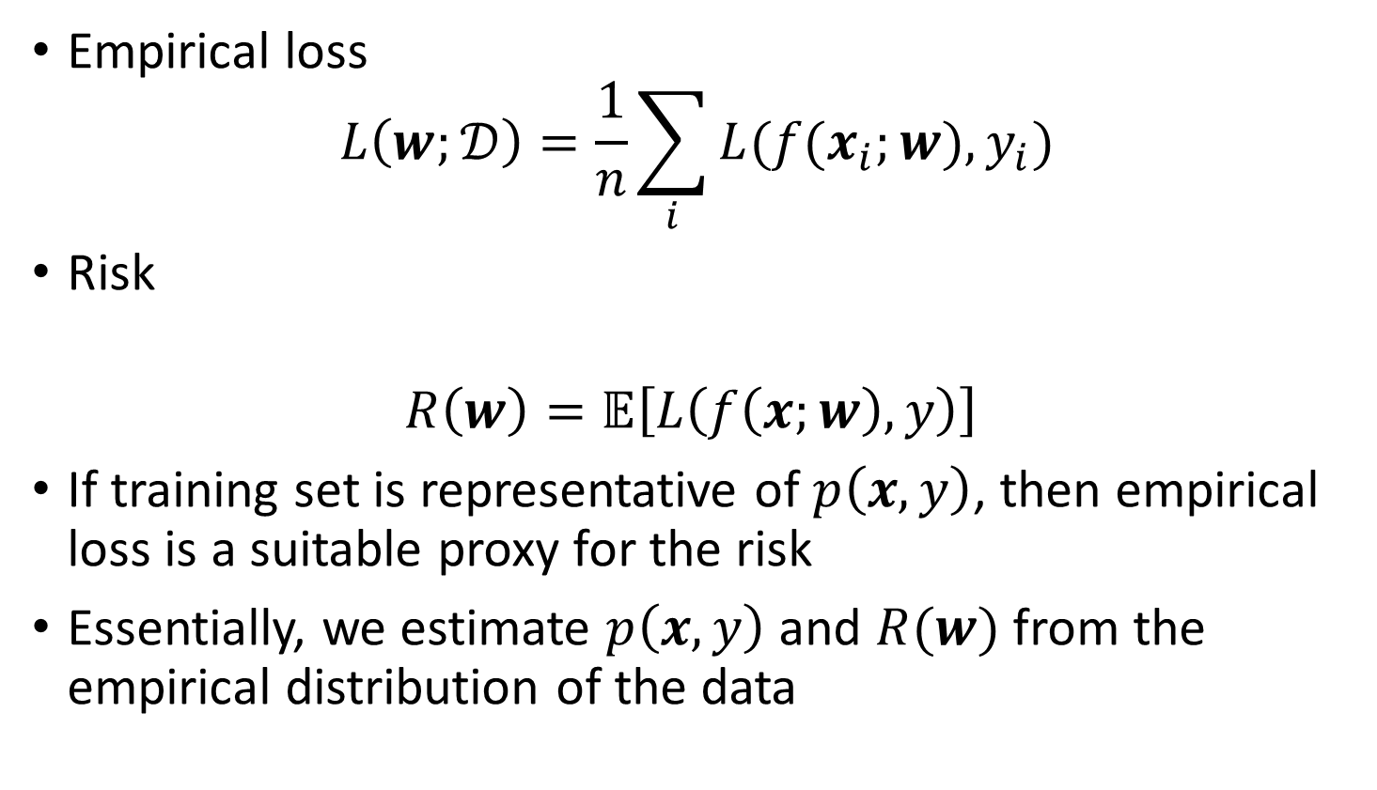
Empirical risk (loss) minimization
Empirical loss
$$L\left(w;𝒟\right)=\frac{1}{n}\sum_{i}{L(f(x_{i};w),y_{i})}$$
Risk
$$R\left(w\right)=𝔼\left[L\left(f\left(x;w\right),y\right)\right]$$
If training set is representative of $p\left(x,y\right)$, then empirical loss is a suitable proxy for the risk
Essentially, we estimate $p\left(x,y\right)$ and $R(w)$ from the empirical distribution of the data

Slide 29
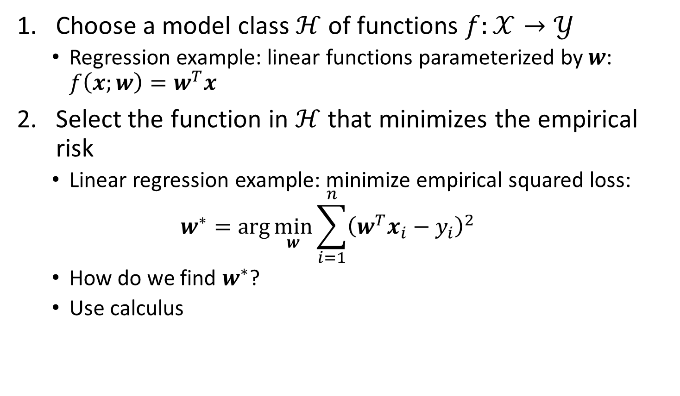
Empirical risk minimization
Choose a model class $ℋ$ of functions $f:𝒳→𝒴$
Regression example: linear functions parameterized by $w$: $f\left(x;w\right)=w^{T}x$
Select the function in $ℋ$ that minimizes the empirical risk
Linear regression example: minimize empirical squared loss:
$$w^{∗}=\arg{\min_{w}{\sum_{i=1}^{n}{{\left(w^{T}x_{i}−y_{i}\right)}^{2}}}}$$
How do we find $w^{∗}$?
Use calculus

Slide 30
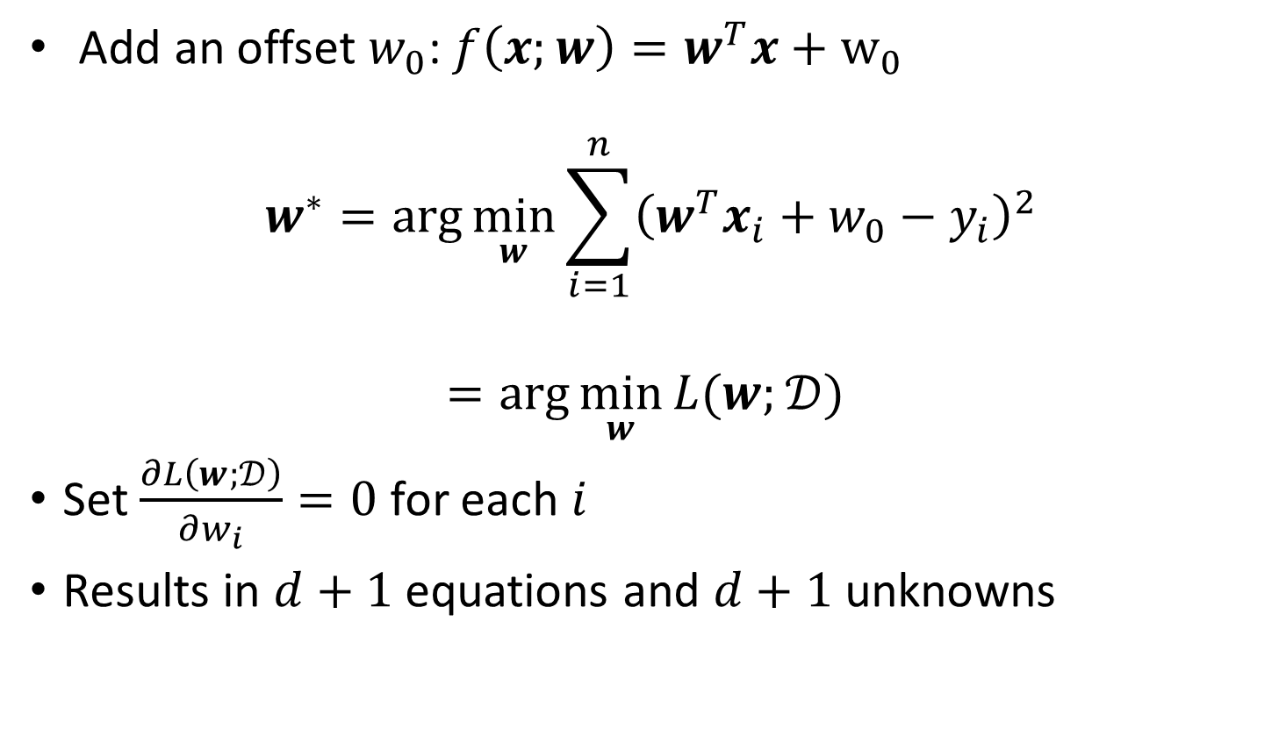
Linear Regression Optimization
Add an offset $w_{0}$: $f\left(x;w\right)=w^{T}x+w_{0}$
$$w^{∗}=\arg{\min_{w}{\sum_{i=1}^{n}{{\left(w^{T}x_{i}+w_{0}−y_{i}\right)}^{2}}}}$$
$$=\arg{\min_{w}{L(w;}𝒟) }$$
Set $\frac{∂L\left(w;𝒟\right)}{∂w_{i}}=0$ for each $i$
Results in $d+1$ equations and $d+1$ unknowns

Slide 31
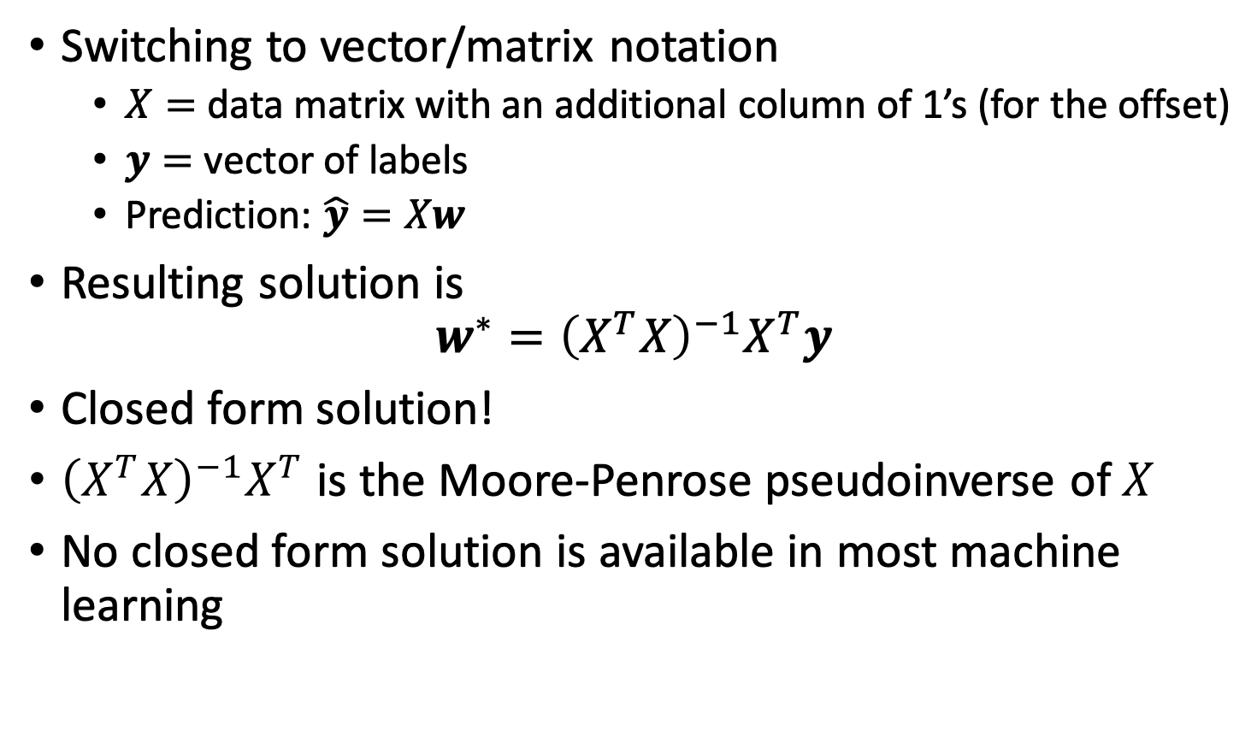
Linear Regression
Switching to vector/matrix notation
$X=$ data matrix with an additional column of 1’s (for the offset)
$y=$ vector of labels
Prediction: $\hat{y}=Xw$
Resulting solution is
$$w^{∗}={\left(X^{T}X\right)}^{−1}X^{T}y$$
Closed form solution!
${\left(X^{T}X\right)}^{−1}X^{T}$ is the Moore-Penrose pseudoinverse of $X$
No closed form solution is available in most machine learning

Slide 32
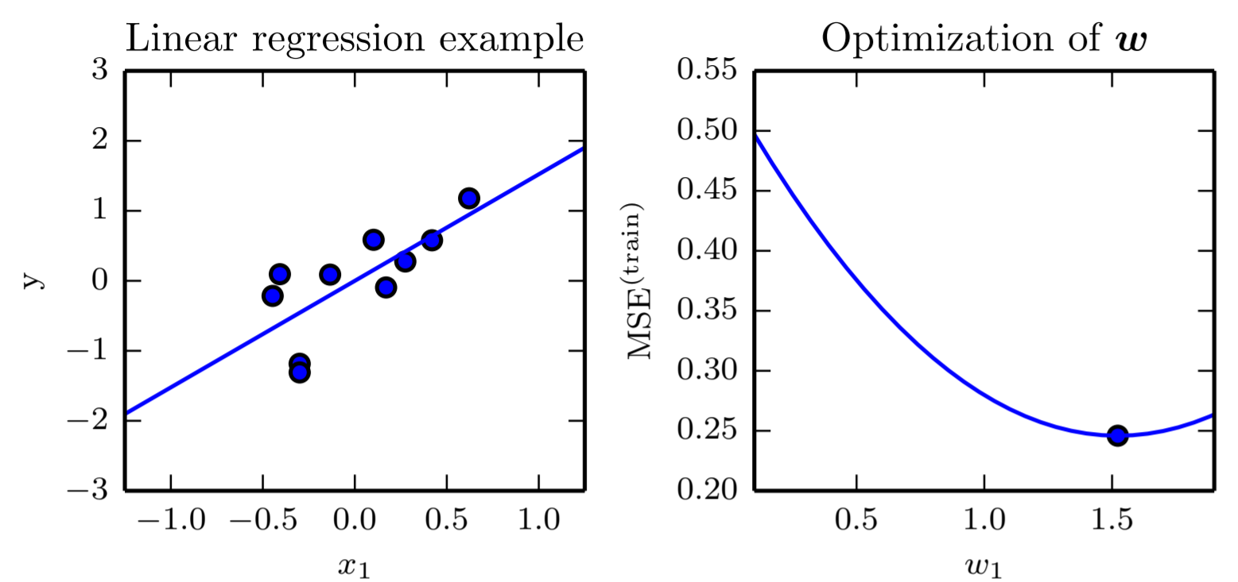
Linear Regression Example
Goodfellow et al., 2016

Slide 33
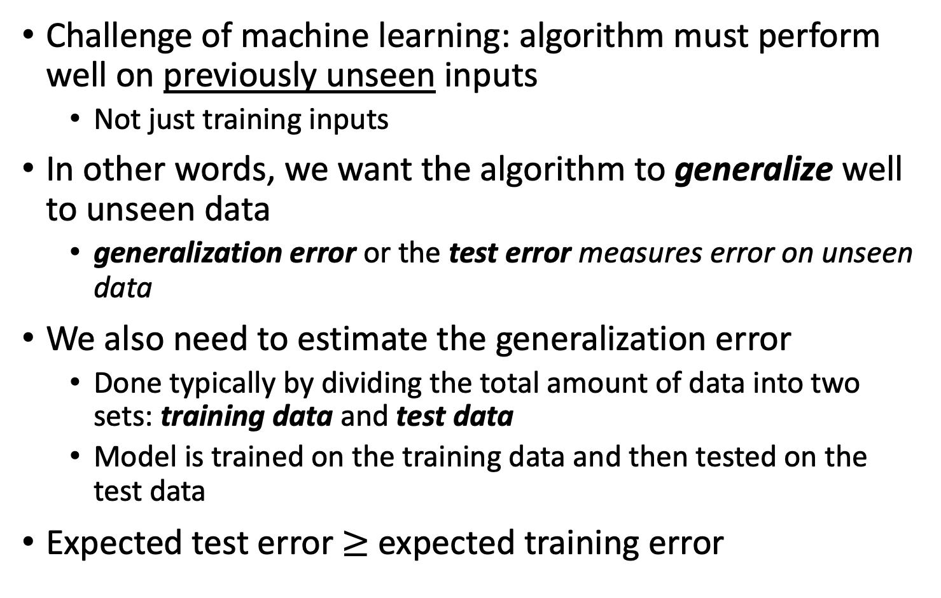
Training vs Test Error
Challenge of machine learning: algorithm must perform well on previously unseen inputs
Not just training inputs
In other words, we want the algorithm to generalize well to unseen data
generalization error or the test error measures error on unseen data
We also need to estimate the generalization error
Done typically by dividing the total amount of data into two sets: training data and test data
Model is trained on the training data and then tested on the test data
Expected test error $≥$ expected training error
Notes:
Both training and test error are important

Slide 34
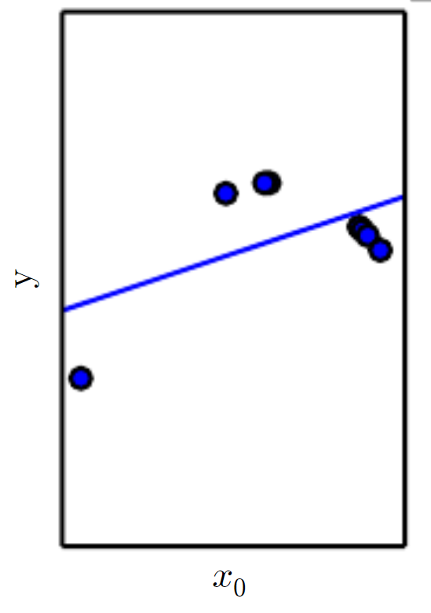
Underfitting
Many processes are not well modeled by linear functions
Biological systems
Stock market prices
Periodic signals
In these cases, linear functions can underfit the data
Training error is very high
Test error will also be high
Goodfellow et al., 2016
Notes:
Data was sampled from a quadratic function

Slide 35
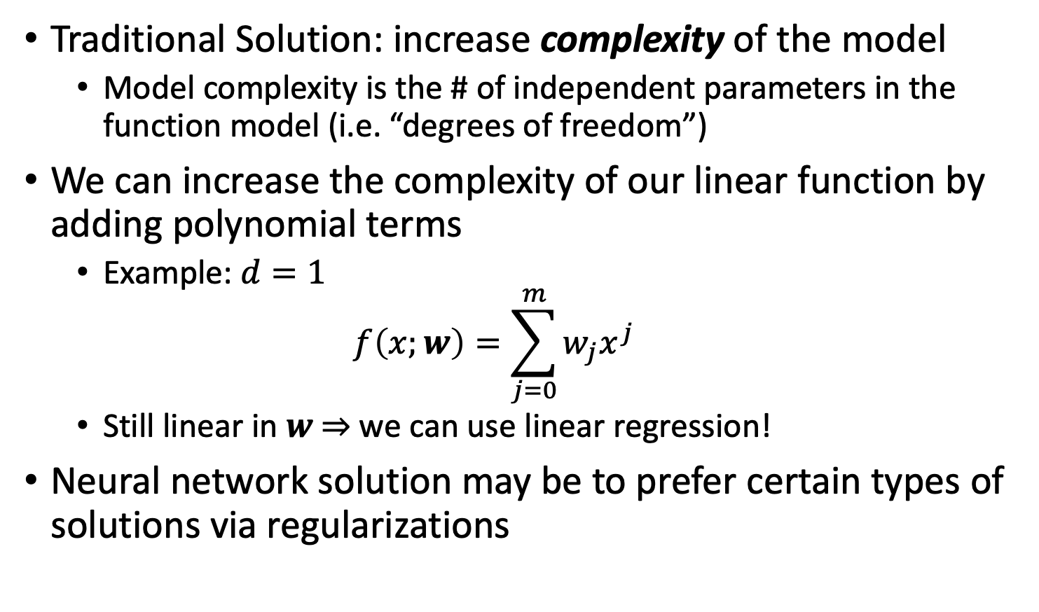
Model Complexity/Capacity
Traditional Solution: increase complexity of the model
Model complexity is the # of independent parameters in the function model (i.e. “degrees of freedom”)
We can increase the complexity of our linear function by adding polynomial terms
Example: $d=1$
$$f\left(x;w\right)=\sum_{j=0}^{m}{w_{j}x^{j}}$$
Still linear in $w$ $⇒$ we can use linear regression!
Neural network solution may be to prefer certain types of solutions via regularizations

Slide 36
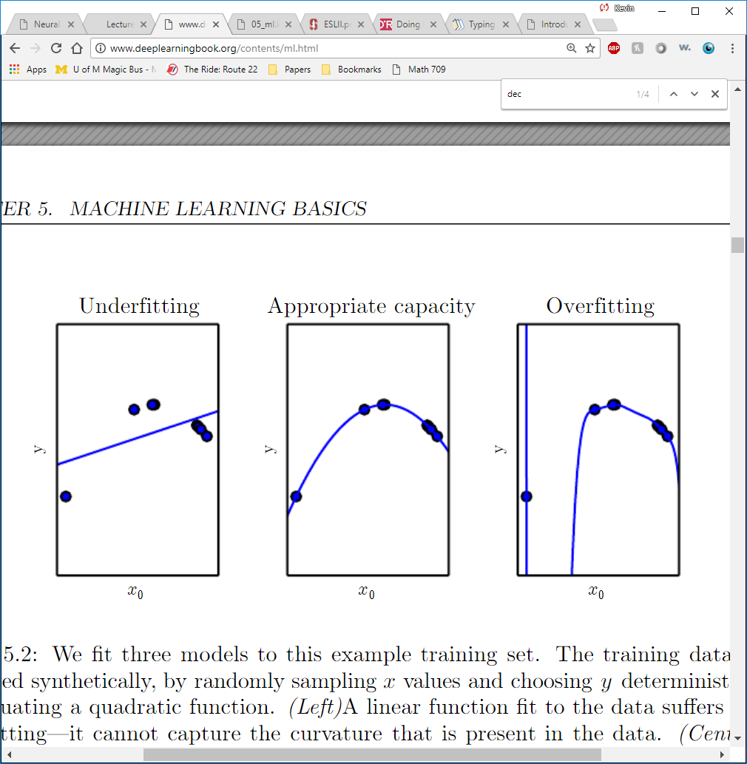
Nonlinear Regression
Goodfellow et al., 2016
Notes:
This enables us to match the data better and obtain a very low training error and also low generalization error if the model is correct. What if the model isn’t correct though and it’s too complex?

Slide 37
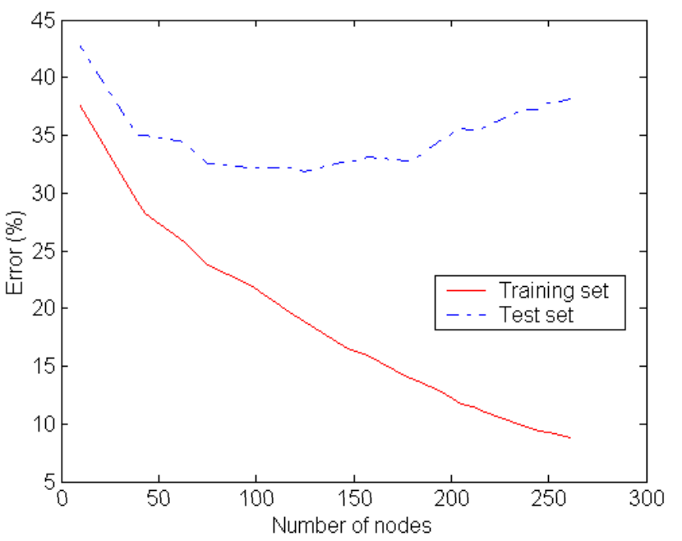
Overfitting
Overfitting occurs when the gap between training error and test error is too large
The model is capturing unique characteristics of the training set
The model does not generalize well to new samples
Occurs when the complexity is too large
Avoiding overfitting
Generally requires the use of another test set for evaluation
Traditionally: decrease complexity
Notes:
This is a major issue with deep learning as the number of parameters (i.e. model complexity) can grow quite quickly

Slide 38
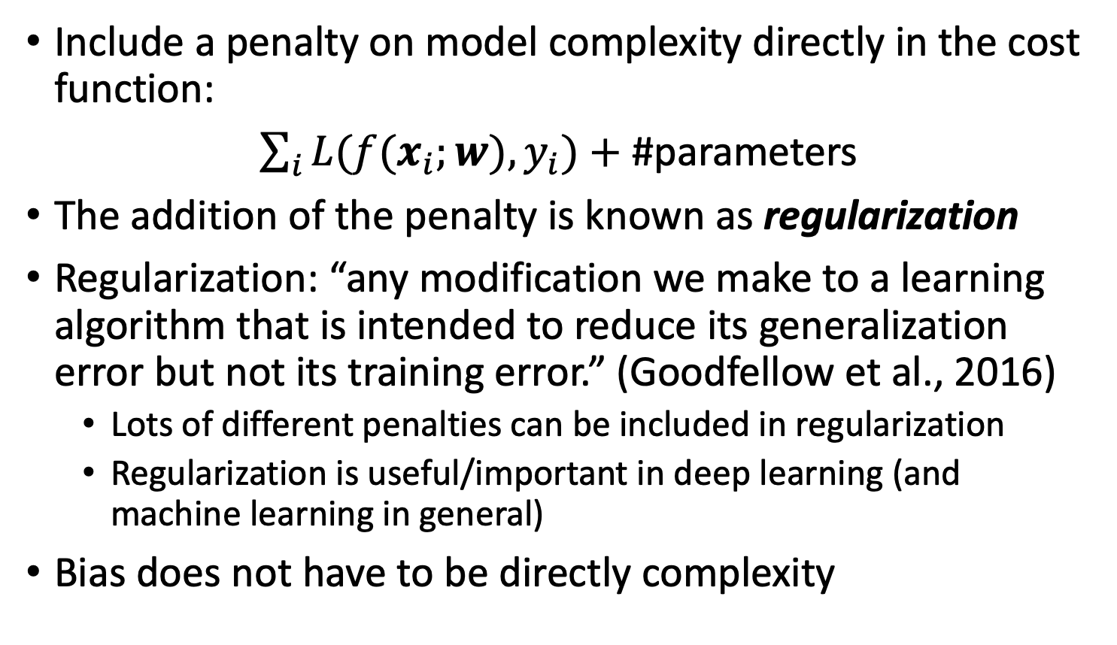
Inductive bias for simplicity
Include a penalty on model complexity directly in the cost function:
$\sum_{i}{L(f(x_{i};w),y_{i})}+$ #parameters
The addition of the penalty is known as regularization
Regularization: “any modification we make to a learning algorithm that is intended to reduce its generalization error but not its training error.” (Goodfellow et al., 2016)
Lots of different penalties can be included in regularization
Regularization is useful/important in deep learning (and machine learning in general)
Bias does not have to be directly complexity
Notes:
We can also build a penalty on model complexity directly into our algorithm

Slide 39
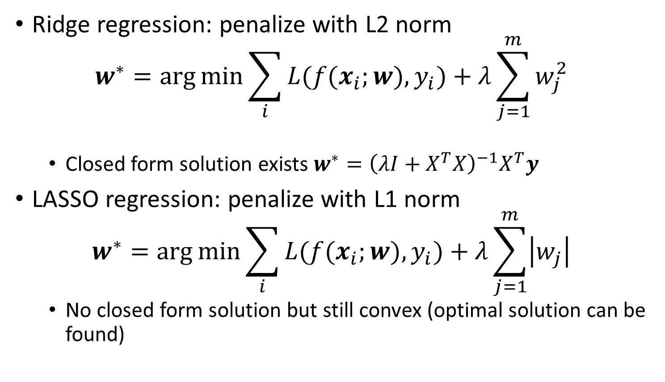
Regularization
Ridge regression: penalize with L2 norm
$$w^{∗}=\arg{\min{\sum_{i}{L(f(x_{i};w),y_{i})}+λ\sum_{j=1}^{m}{w_{j}^{2}}}}$$
Closed form solution exists $w^{∗}={\left(λI+X^{T}X\right)}^{−1}X^{T}y$
LASSO regression: penalize with L1 norm
$$w^{∗}=\arg{\min{\sum_{i}{L(f(x_{i};w),y_{i})}+λ\sum_{j=1}^{m}{\left|w_{j}\right|}}}$$
No closed form solution but still convex (optimal solution can be found)

Slide 40
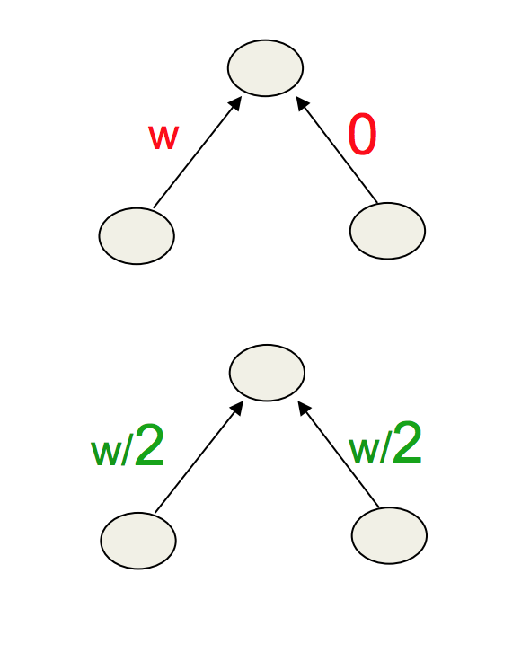
L1 vs L2
Prefers to share smaller weights
Makes model smoother
More Convex

Slide 41
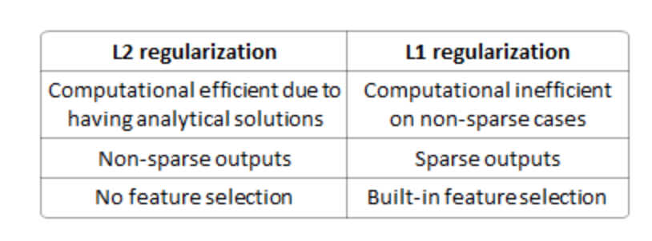
L1 vs L2

Slide 42
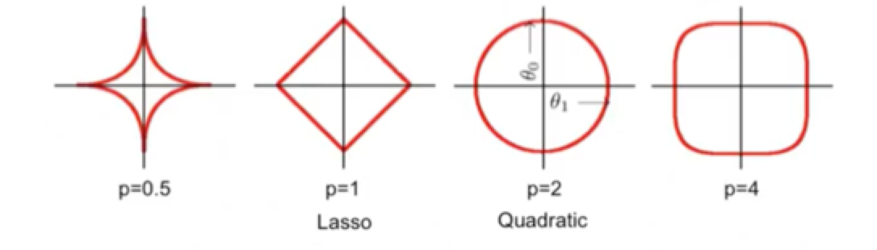
Lp Regularization
Isosurfaces
As p→0 you get a counting penalty

Slide 43
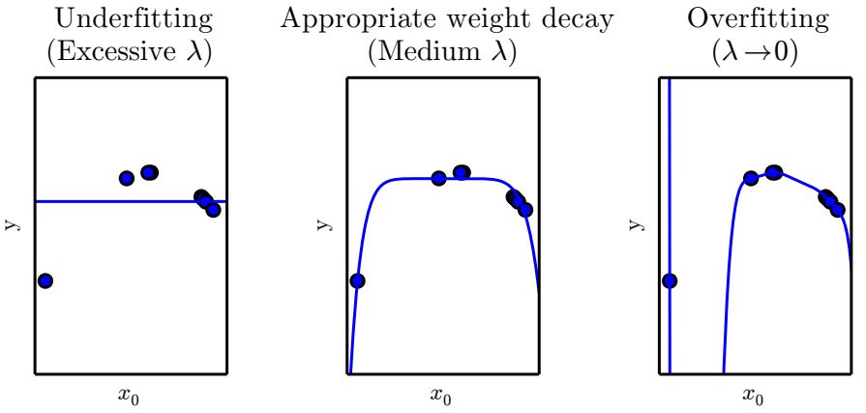
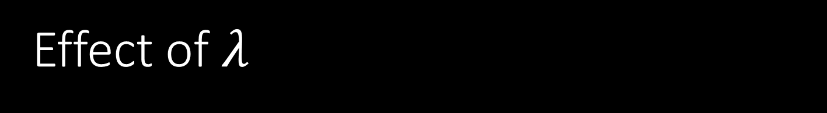
Effect of $λ$
Goodfellow et al., 2016

Slide 44
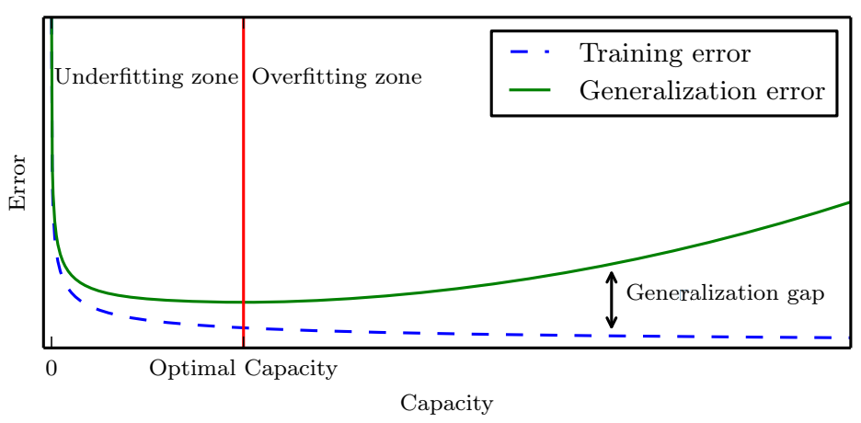
Underfit/Overfit Paradigm
Goodfellow et al., 2016

Slide 45

Conventional Wisdom Doesn’t work!

Slide 46
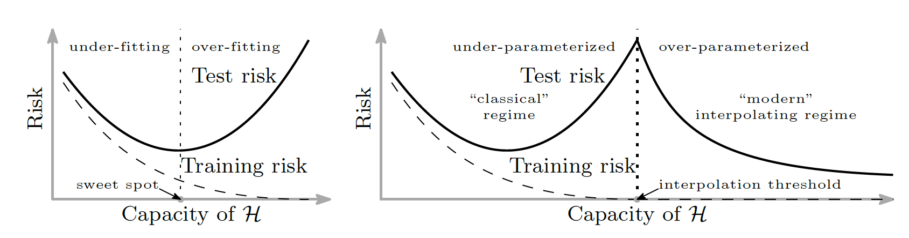
New “Interpolation” Regime

Slide 47
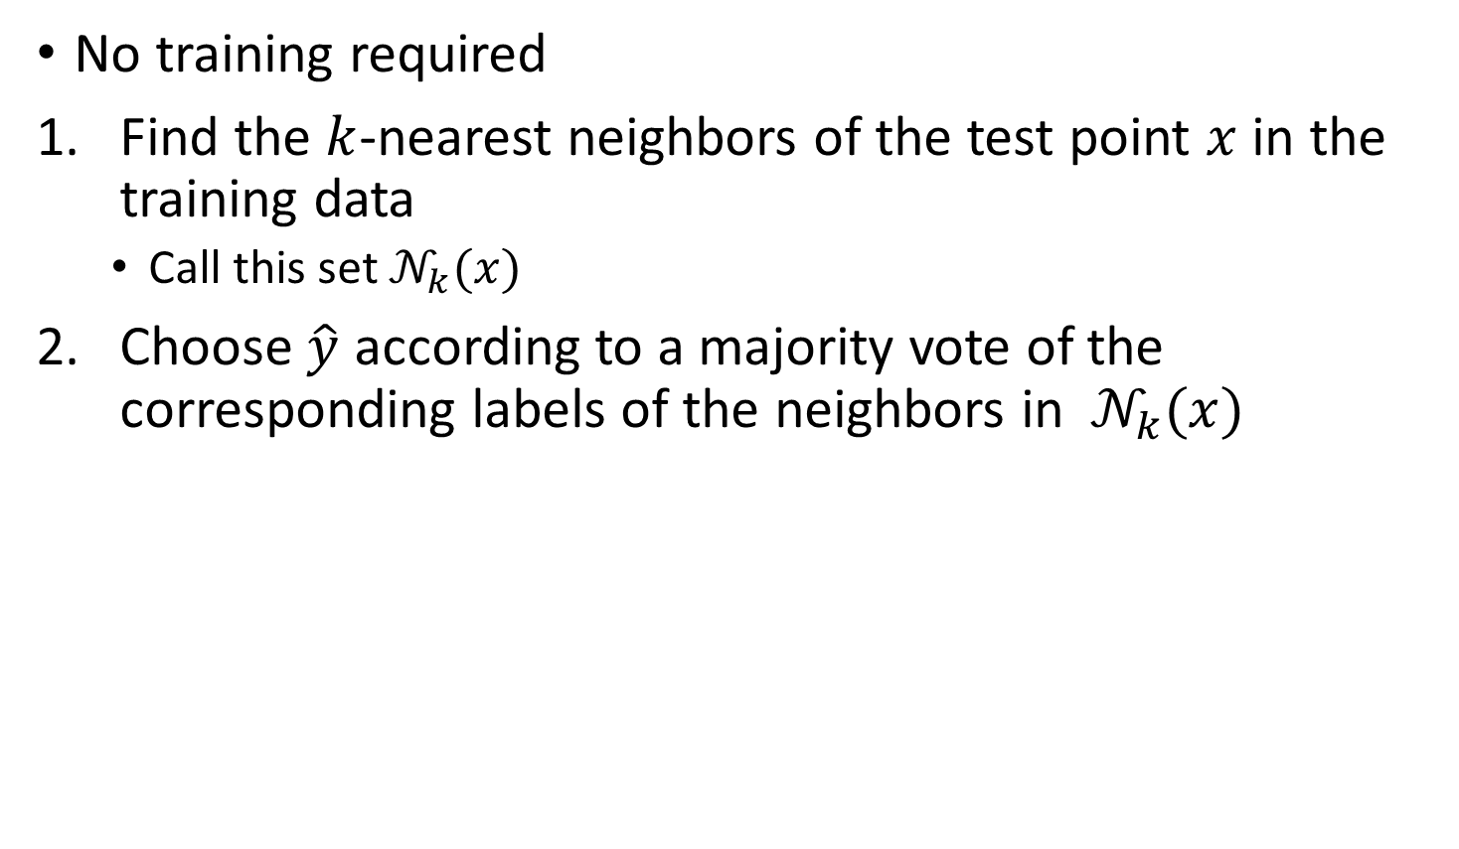
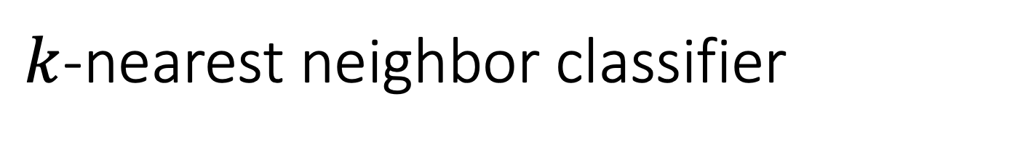
$k$-nearest neighbor classifier
No training required
Find the $k$-nearest neighbors of the test point $x$ in the training data
Call this set $𝒩_{k}(x)$
Choose $\hat{y}$ according to a majority vote of the corresponding labels of the neighbors in $𝒩_{k}(x)$

Slide 48
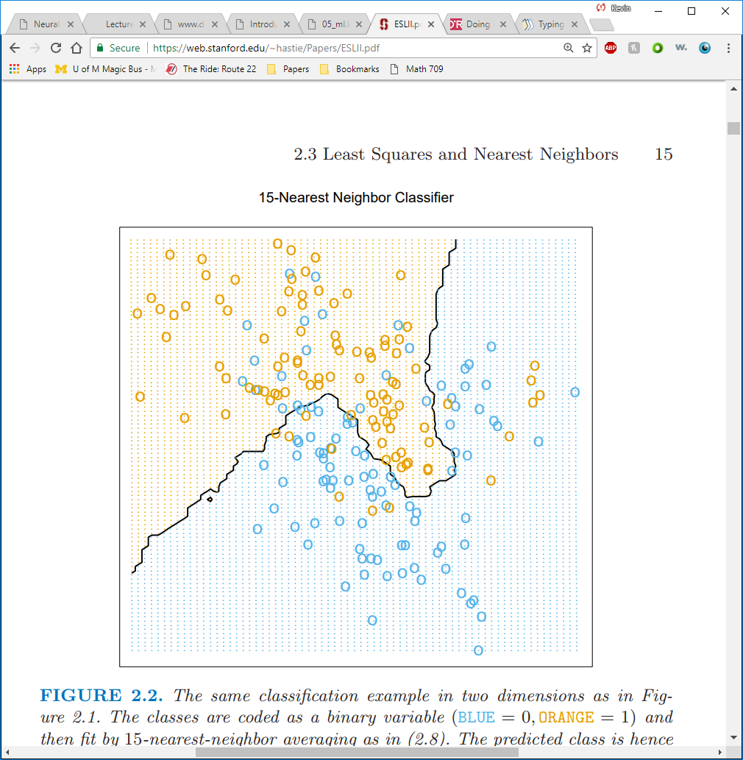
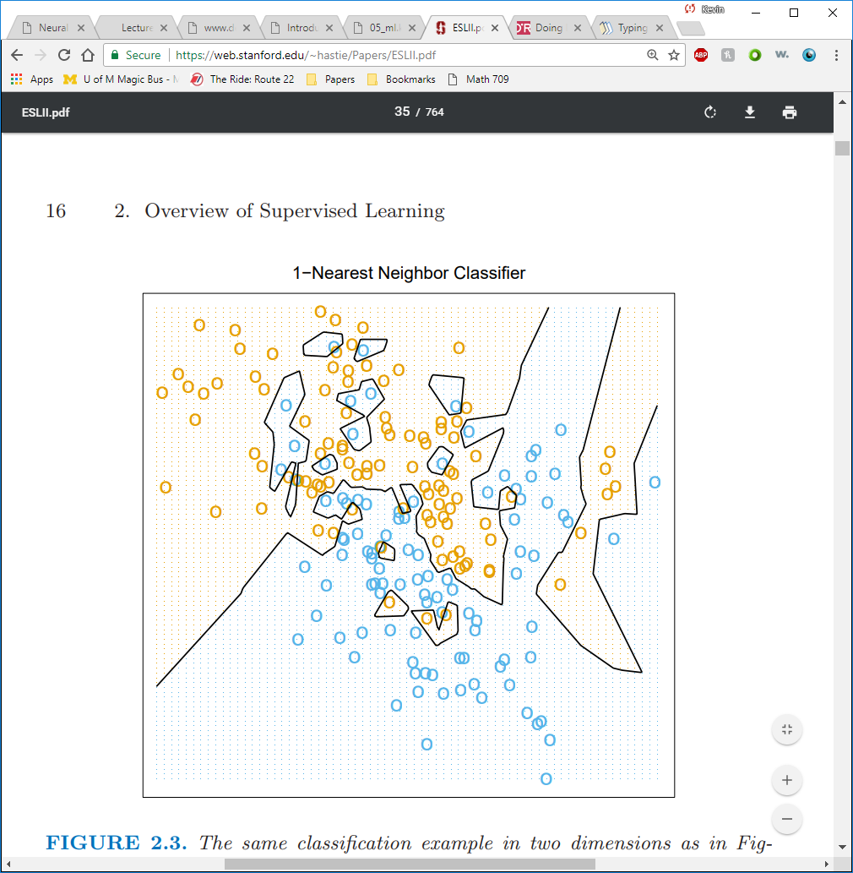
$k$-nearest neighbor classifier
Interpolation Regime
Hastie et al., 2009

Slide 49
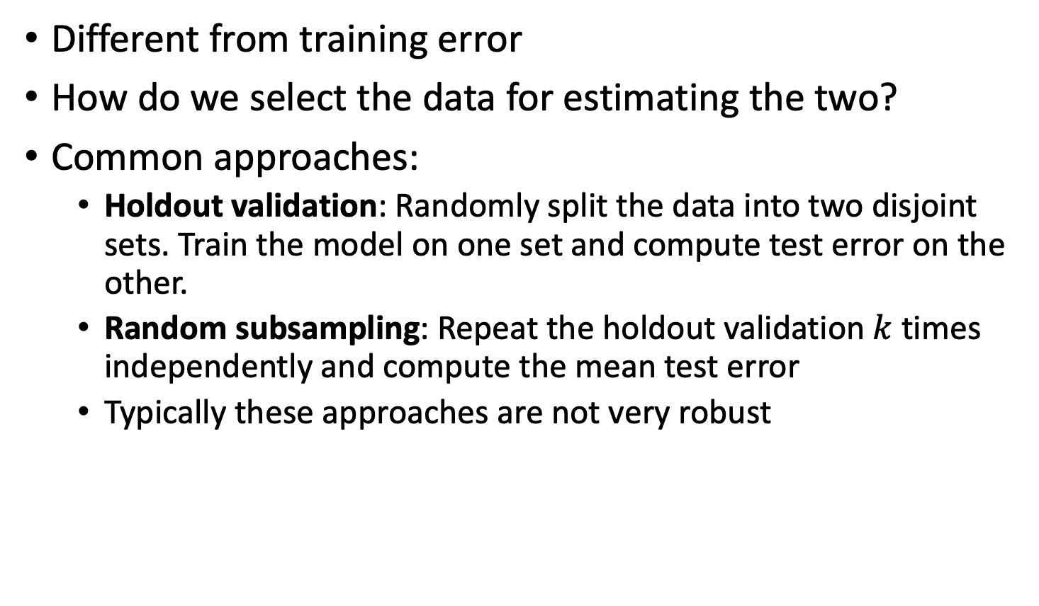
Measuring test error
Different from training error
How do we select the data for estimating the two?
Common approaches:
Holdout validation: Randomly split the data into two disjoint sets. Train the model on one set and compute test error on the other.
Random subsampling: Repeat the holdout validation $k$ times independently and compute the mean test error
Typically these approaches are not very robust

Slide 50
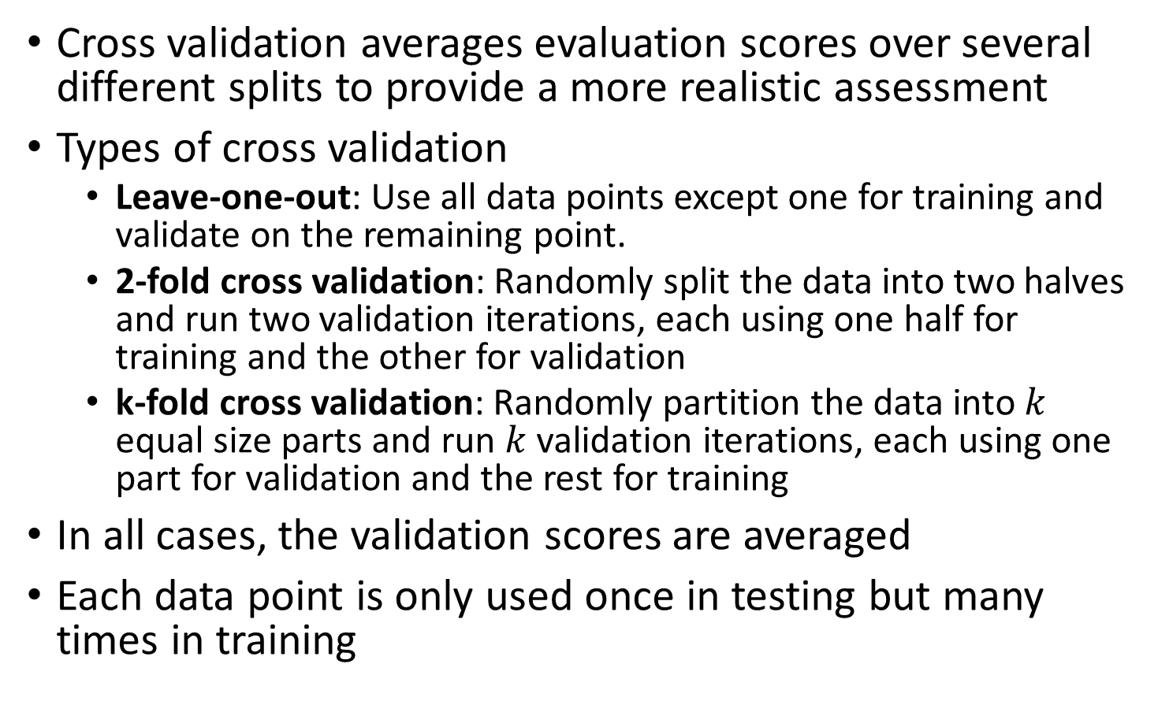
Cross Validation
Cross validation averages evaluation scores over several different splits to provide a more realistic assessment
Types of cross validation
Leave-one-out: Use all data points except one for training and validate on the remaining point.
2-fold cross validation: Randomly split the data into two halves and run two validation iterations, each using one half for training and the other for validation
k-fold cross validation: Randomly partition the data into $k$ equal size parts and run $k$ validation iterations, each using one part for validation and the rest for training
In all cases, the validation scores are averaged
Each data point is only used once in testing but many times in training

Slide 51
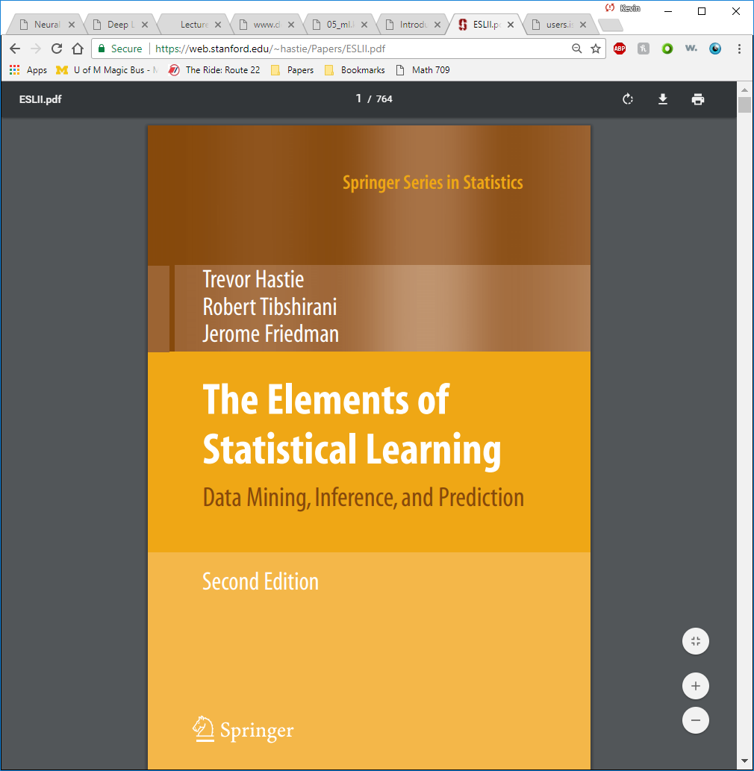
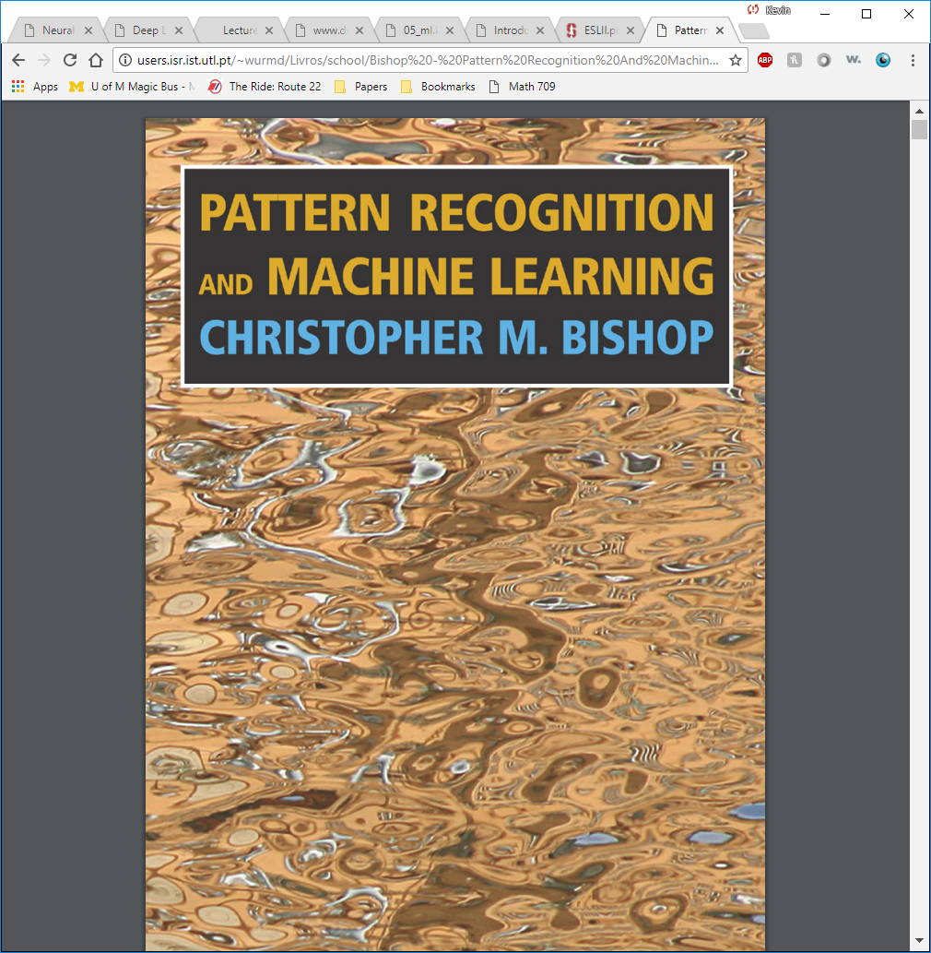
Further reading
Chapter 5 in Goodfellow book
Elements of Statistical Learning by Hastie, Tibshirani, & Friedman
Pattern Recognition and Machine Learning by Bishop

